Slide 1
Paper Outlines
40 Topics

Slide 2
Table 1
Journal | First Publication | Number of Abstracts
Academic Emergency Medicine | 1994 | 4452
American Journal of Emergency Medicine | 1983 | 5587
Annals of Emergency Medicine | 1980 | 5364
BMC Emergency Medicine | 2001 | 496
Journal of Emergency Medicine | 1983 | 3161
The Western Journal of Emergency Medicine | 2007 | 1468

Slide 3
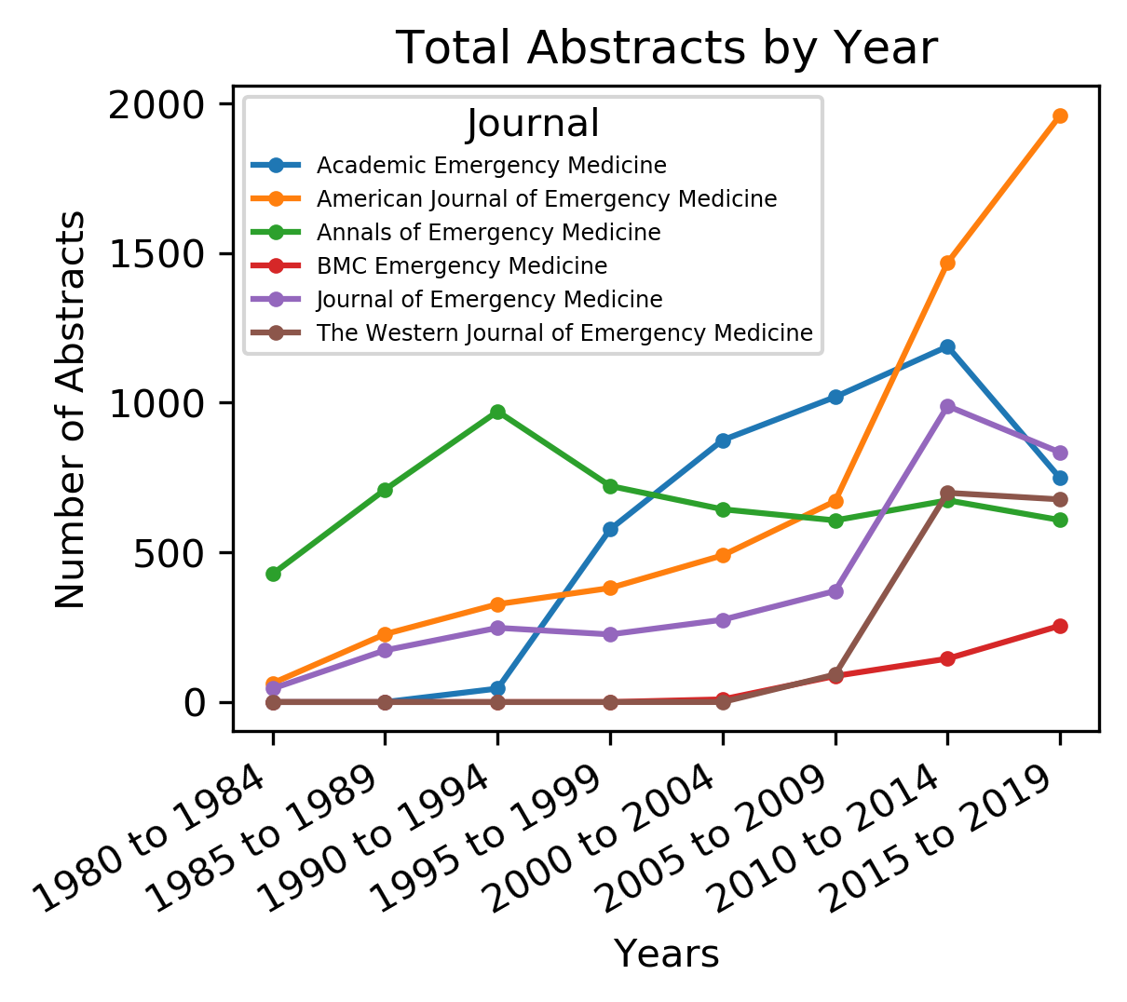
Figure 1

Slide 4
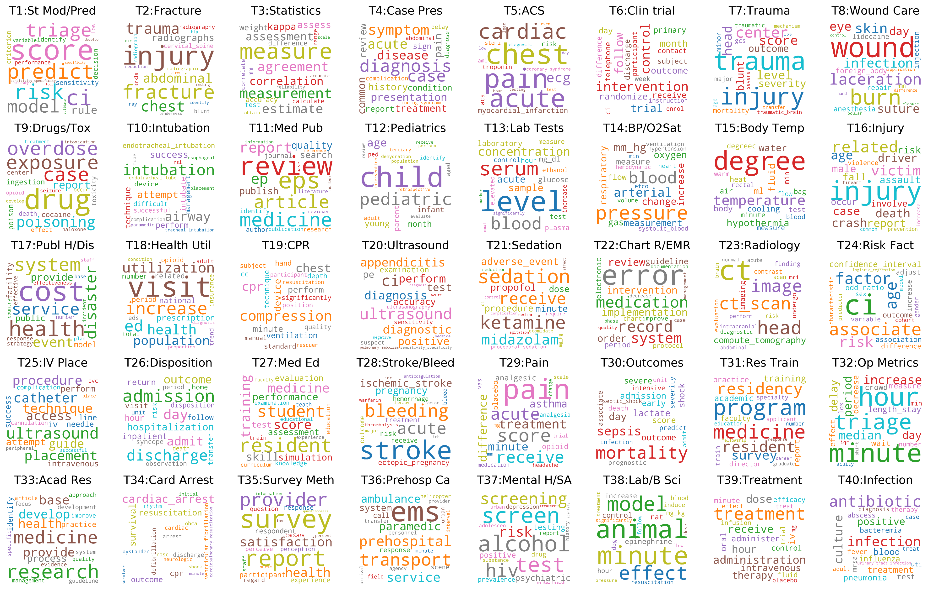
Figure 2 Word Clouds

Slide 5
Table 2
Topic | Name | Keywords | Document Count
1 | St Mod/Pred | score, ci, predict, risk, triage, model, rule, sensitivity, decision, criterion | 464
2 | Fracture | injury, fracture, trauma, chest, abdominal, radiographs, cervical_spine, radiography, blunt, radiograph | 532
3 | Statistics | measure, measurement, agreement, estimate, assessment, correlation, kappa, assess, weight, accuracy | 327
4 | Case Pres | diagnosis, case, symptom, acute, disease, presentation, common, pain, review, treatment | 879
5 | ACS | chest, pain, acute, cardiac, ecg, myocardial_infarction, risk, troponin, acs, stemi | 688
6 | Clin trial | intervention, control, follow, trial, month, randomize, outcome, receive, day, primary | 445
7 | Trauma | trauma, injury, center, score, head, level, severity, blunt, outcome, mortality | 417
8 | Wound Care | wound, burn, laceration, skin, infection, eye, suture, day, foreign_body, anesthesia | 403
9 | Drugs/Tox | drug, exposure, case, overdose, poisoning, report, ingestion, poison, cocaine, toxicity | 552
10 | Intubation | intubation, airway, attempt, success, technique, perform, intubate, endotracheal_intubation, device, difficult | 518
11 | Med Pub | review, eps, medicine, article, report, ep, quality, publish, search, journal | 260
12 | Pediatrics | child, pediatric, age, young, month, infant, parent, ped, aged, adult | 95
13 | Lab Tests | level, serum, blood, concentration, sample, acute, laboratory, glucose, mg_dl, plasma | 504
14 | BP/O2Sat | pressure, blood, arterial, mm_hg, change, oxygen, respiratory, increase, measurement, gas | 499
15 | Body Temp | degree, temperature, fluid, hypothermia, water, ml, body, cooling, air, heat | 277
16 | Injury | injury, related, victim, age, crash, death, case, driver, report, male | 565
17 | Publ H/Dis | cost, health, system, service, disaster, event, provide, public, facility, model | 571
18 | Health Util | visit, increase, ed, utilization, health, population, prescription, national, related, number | 747
19 | CPR | compression, cpr, chest, device, perform, minute, ventilation, technique, hand, standard | 356
20 | Ultrasound | ultrasound, ci, appendicitis, diagnosis, diagnostic, perform, positive, test, pe, accuracy | 637

Slide 6
Table 2
Topic | Name | Keywords | Document Count
21 | Sedation | sedation, ketamine, receive, midazolam, adverse_event, propofol, procedure, minute, dose, procedural_sedation | 387
22 | Chart R/EMR | error, medication, record, system, implementation, review, intervention, order, guideline, period | 477
23 | Radiology | ct, head, image, ct_scan, compute_tomography, imaging, finding, undergo, contrast, mri | 345
24 | Risk Fact | ci, associate, factor, age, risk, confidence_interval, outcome, odd_ratio, association, adjust | 315
25 | IV Place | ultrasound, placement, catheter, technique, procedure, access, guide, attempt, iv, perform | 430
26 | Disposition | admission, discharge, day, admit, outcome, hospitalization, inpatient, hour, return, visit | 498
27 | Med Ed | resident, student, training, medicine, score, skill, performance, simulation, assessment, test | 638
28 | Stroke/Bleed | stroke, bleeding, acute, ischemic_stroke, pregnancy, ectopic_pregnancy, risk, treatment, outcome, receive | 267
29 | Pain | pain, score, acute, receive, treatment, difference, minute, asthma, analgesic, opioid | 800
30 | Outcomes | mortality, sepsis, day, lactate, admission, outcome, shock, score, early, severe | 430
31 | Res Train | program, medicine, residency, resident, survey, training, academic, report, practice, faculty | 601
32 | Op Metrics | minute, hour, triage, increase, median, period, day, delay, length_stay, decrease | 634
33 | Acad Res | research, medicine, base, provide, develop, health, process, practice, identify, development | 1198
34 | Card Arrest | cardiac_arrest, survival, resuscitation, cpr, outcome, discharge, defibrillation, cardiac, ventricular_fibrillation, arrest | 554
35 | Survey Meth | survey, report, provider, satisfaction, health, participant, respondent, experience, response, question | 678
36 | Prehosp Ca | ems, transport, prehospital, service, paramedic, ambulance, system, call, response, scene | 494
37 | Mental H/SA | alcohol, screen, test, hiv, screening, risk, psychiatric, testing, positive, prevalence | 458
38 | Lab/B Sci | animal, minute, model, effect, epinephrine, rat, control, increase, hour, mg_kg | 662
39 | Treatment | treatment, administration, dose, receive, hour, therapy, iv, intravenous, administer, oral | 421
40 | Infection | antibiotic, infection, culture, positive, blood, treatment, pneumonia, influenza, test, bacteremia | 505

Slide 7
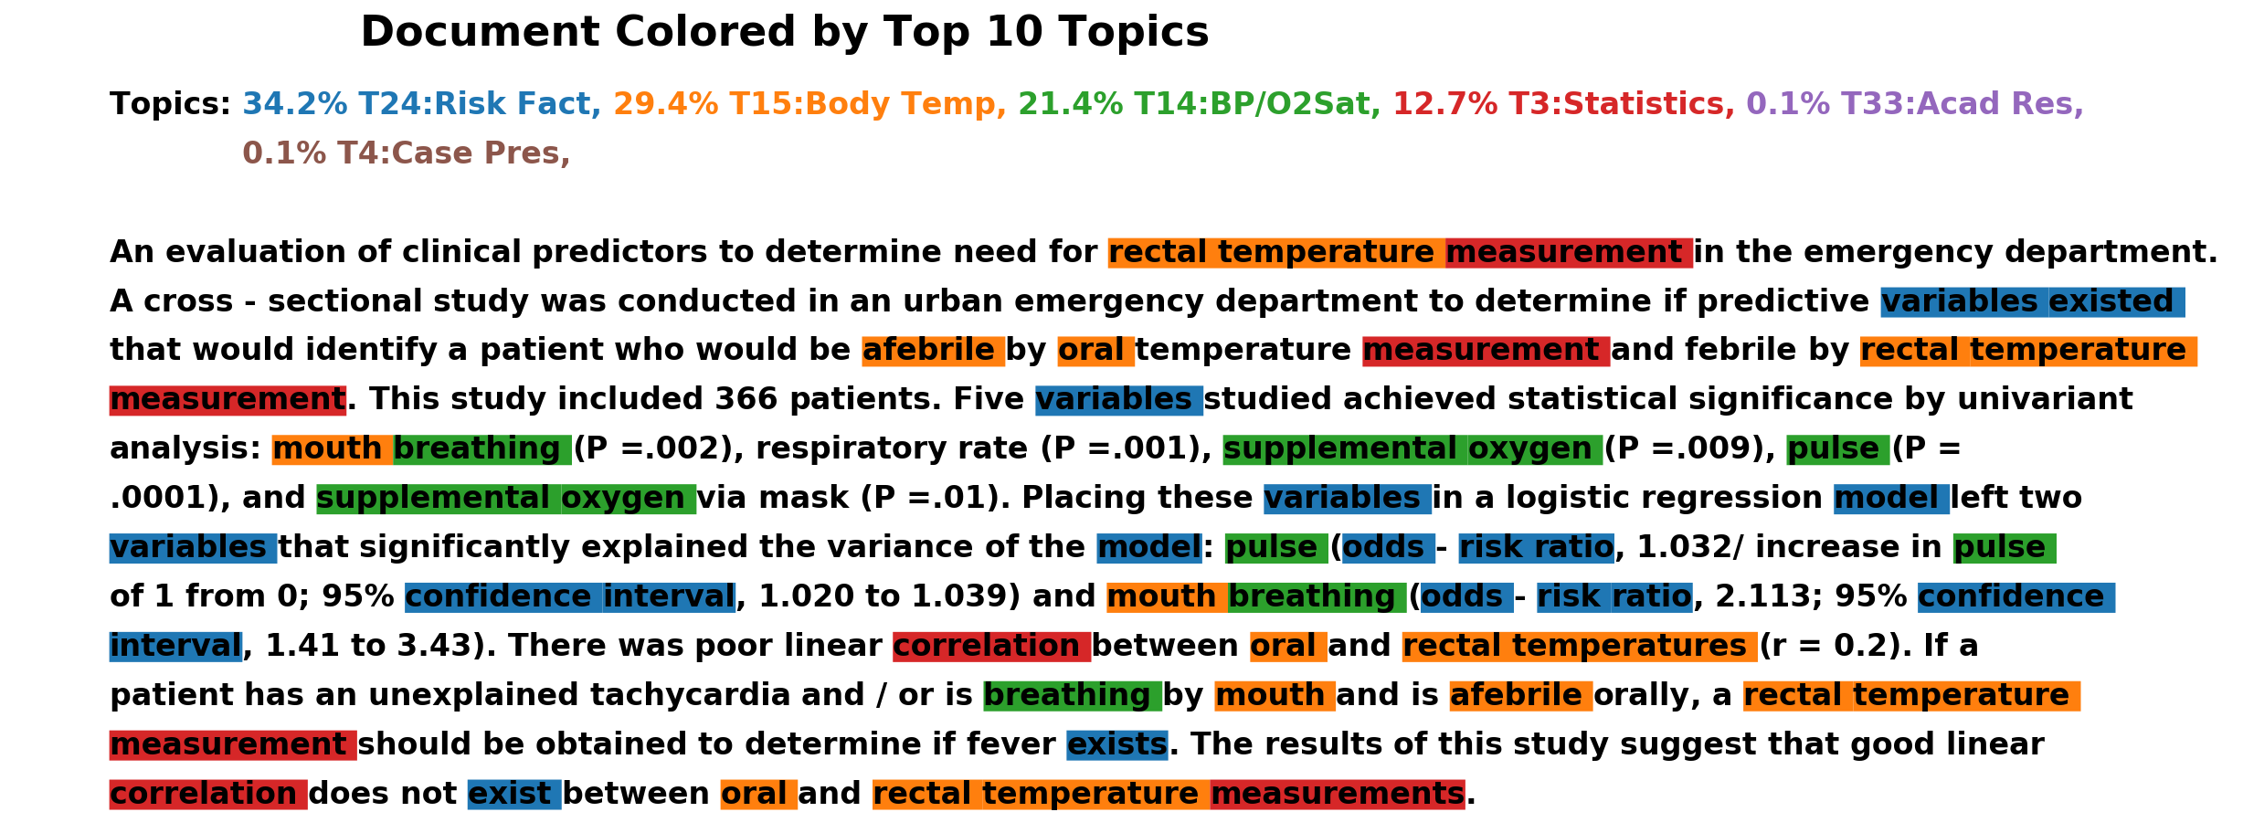
Figure 3 example Paragraph 6545

Slide 8
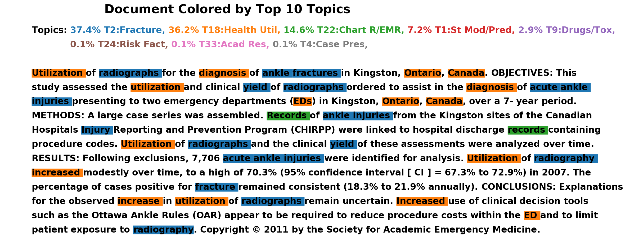
Figure 3 example Paragraph 10891

Slide 9
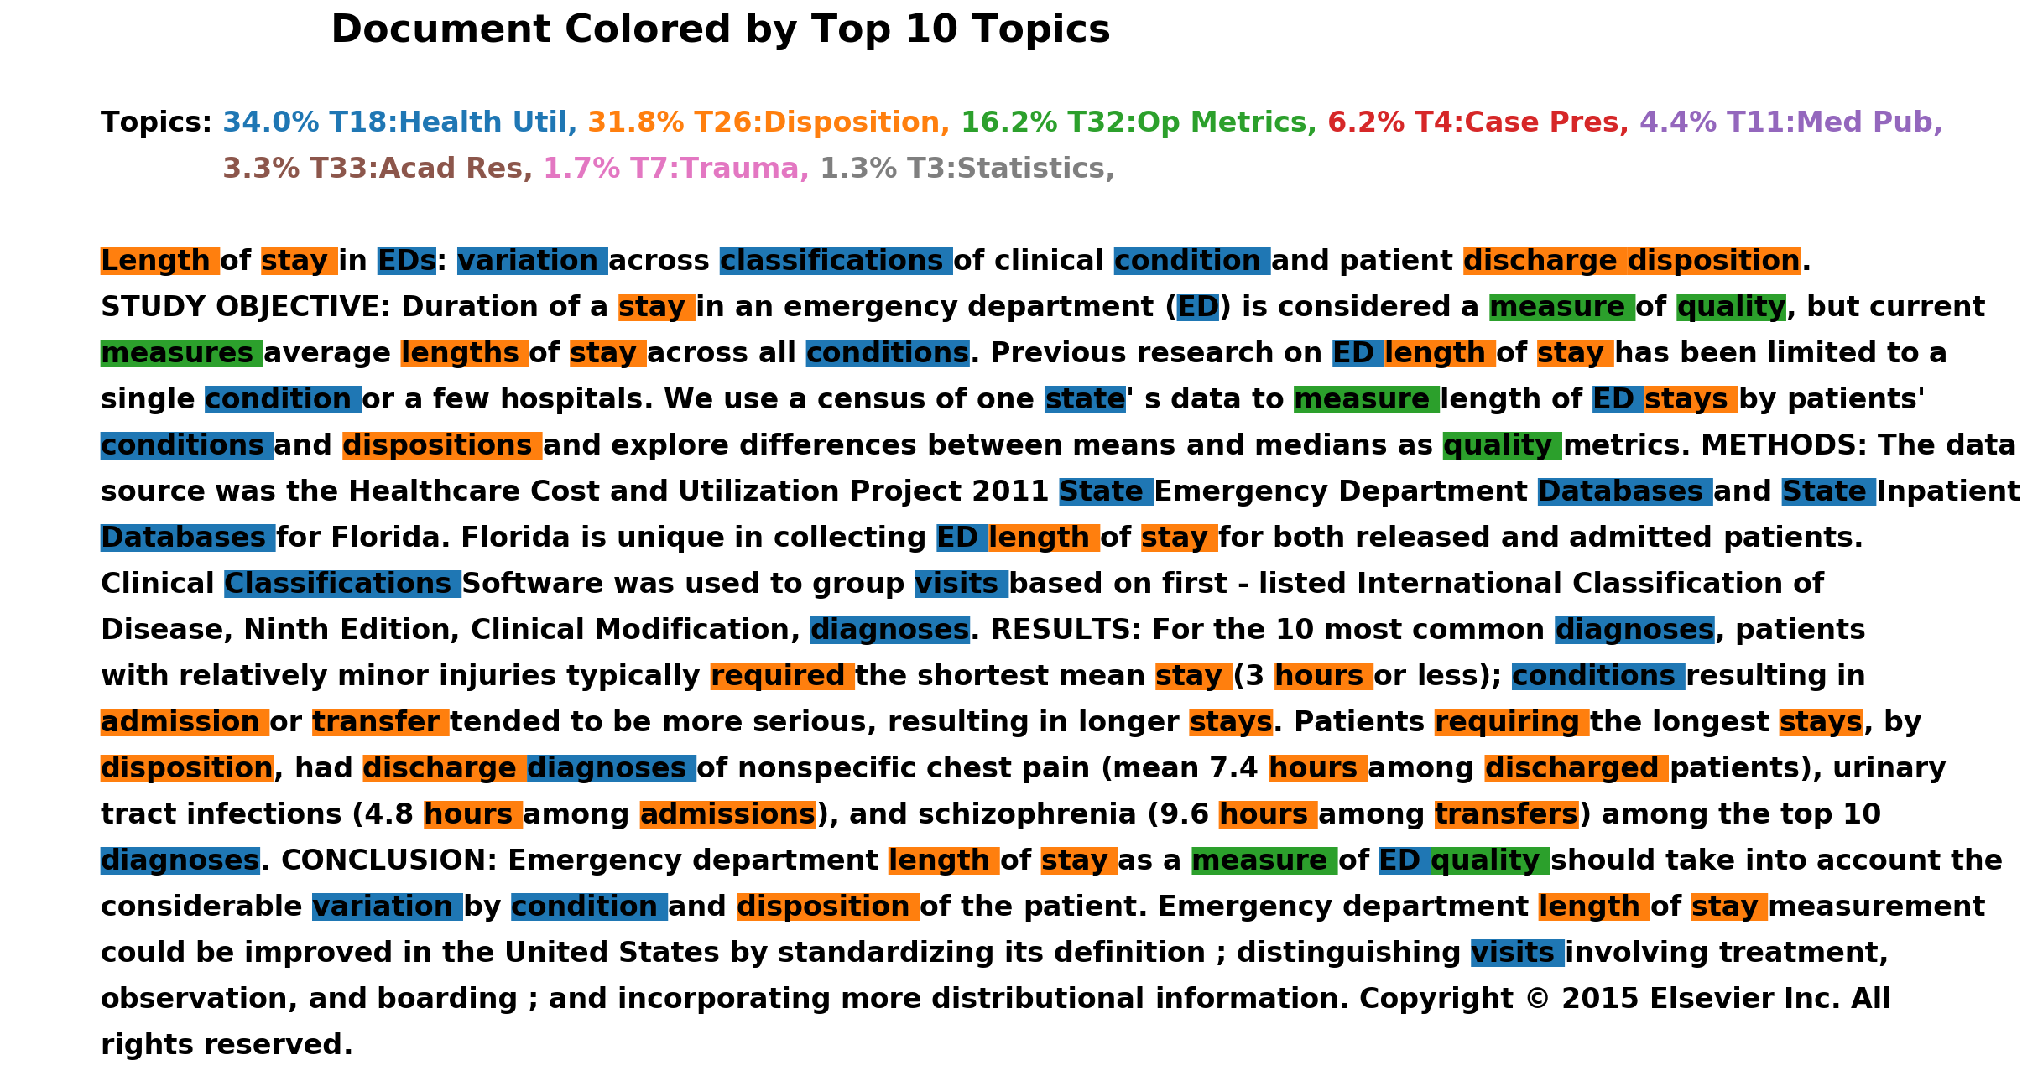
Figure 3 example Paragraph 13422

Slide 10
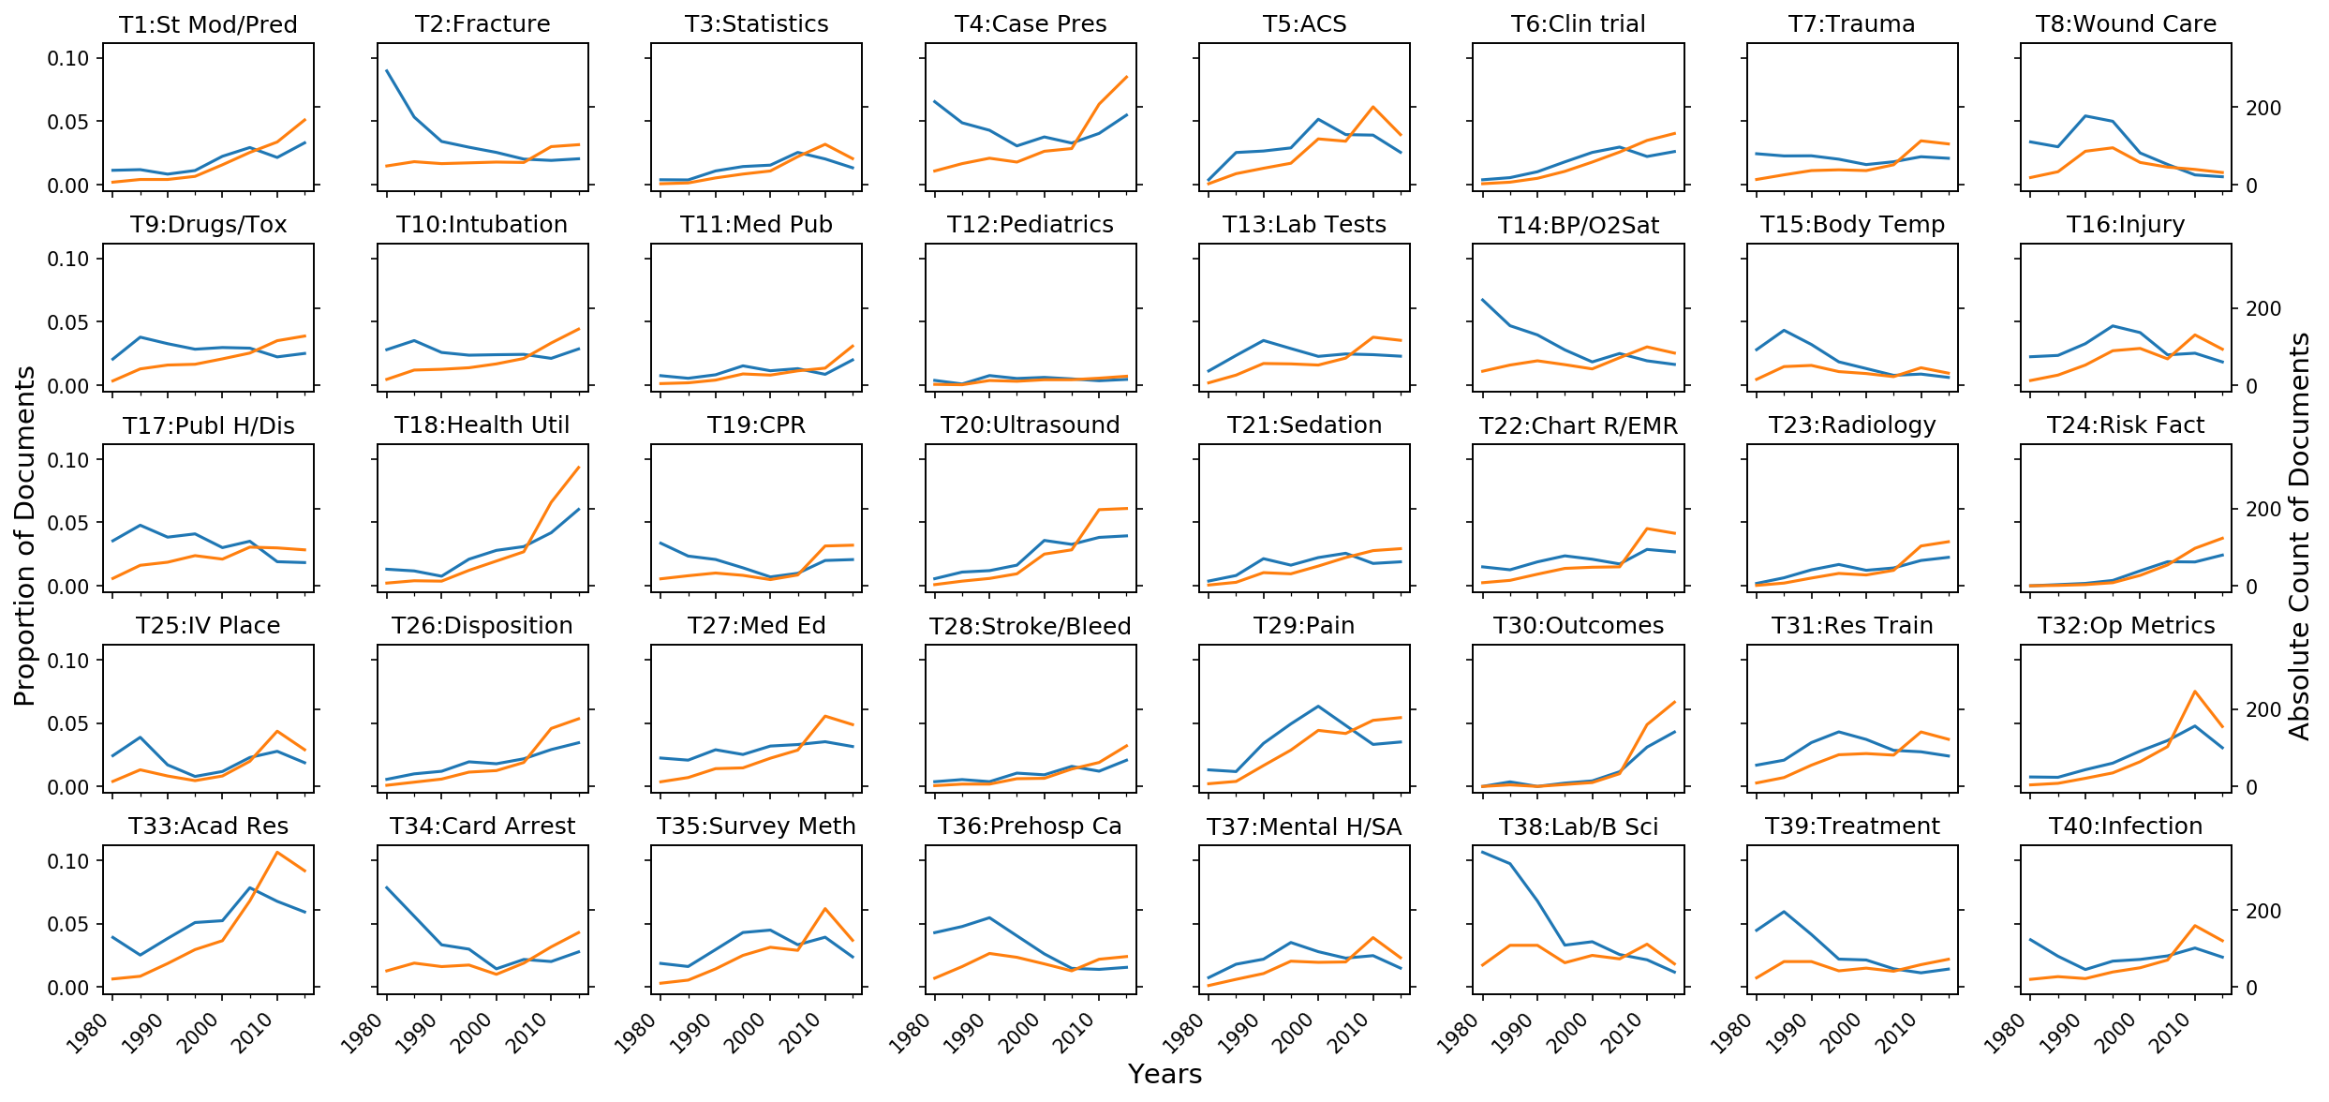
Figure 4 Topic Trends

Slide 11
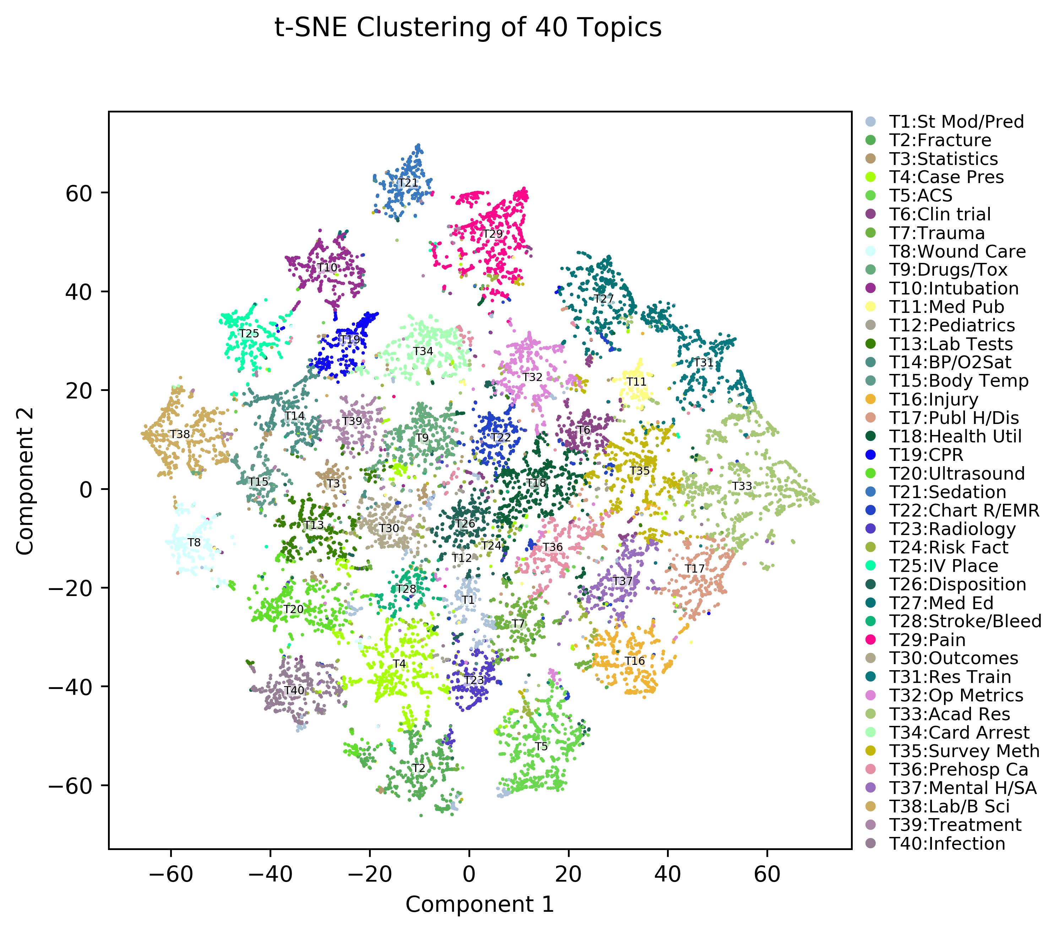
Figure 5 t-SNE cluster of documents

Slide 12
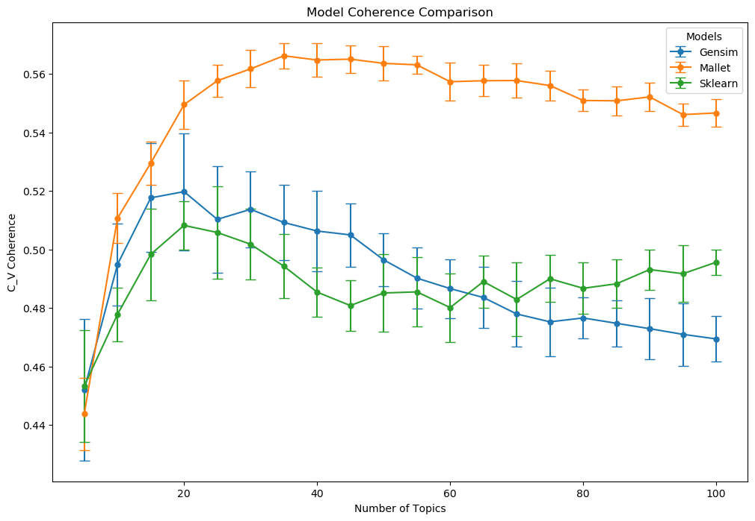
Supplemental Figure 1

Slide 13
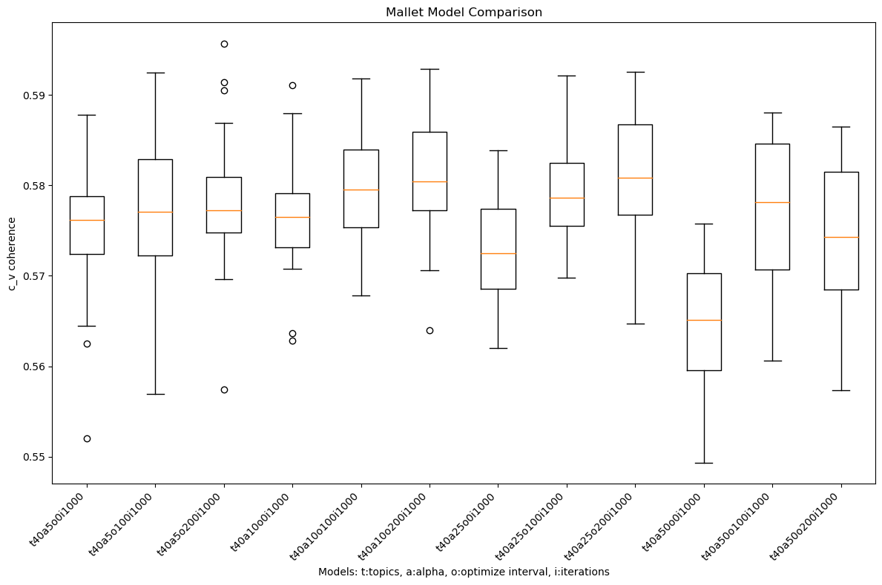
Supplemental Figure 2

Slide 14
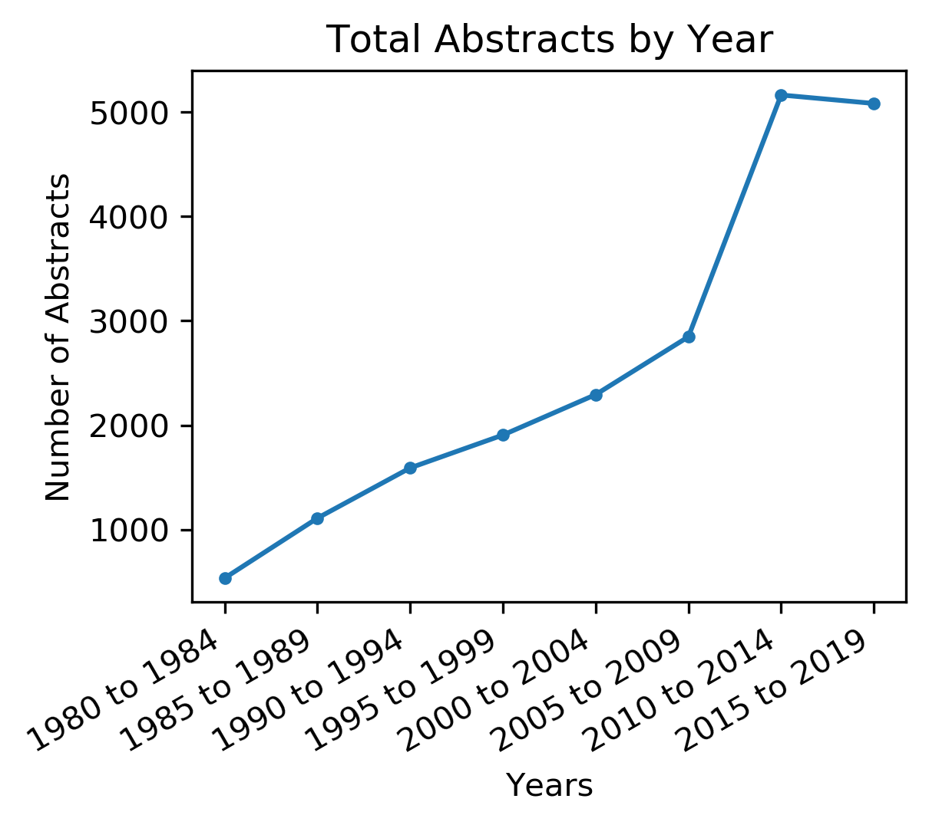
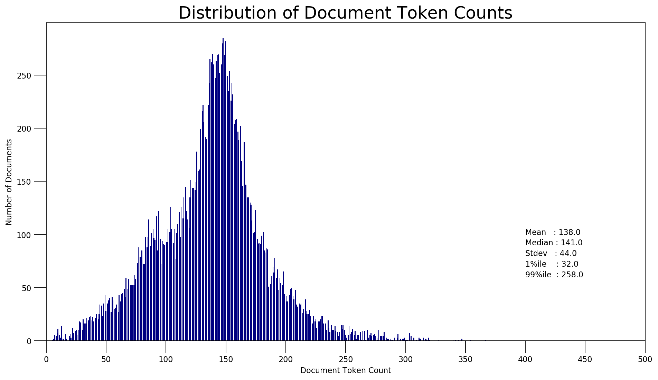
Supplemental Figure 3

Slide 15
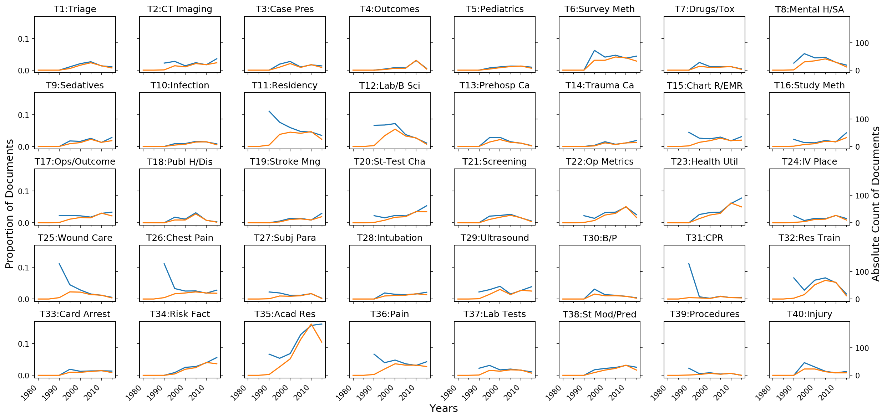
Supplemental Figure 4 – Academic EM

Slide 16
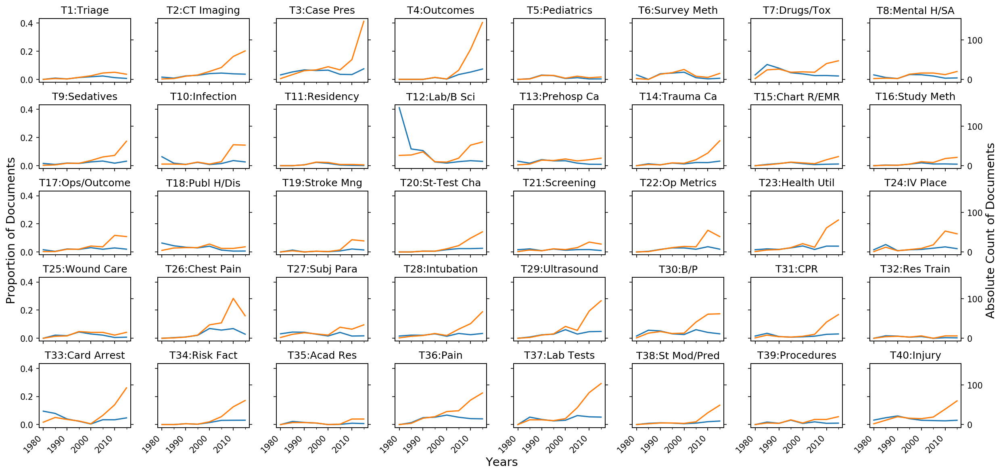
Supplemental Figure 5 – American J of EM

Slide 17
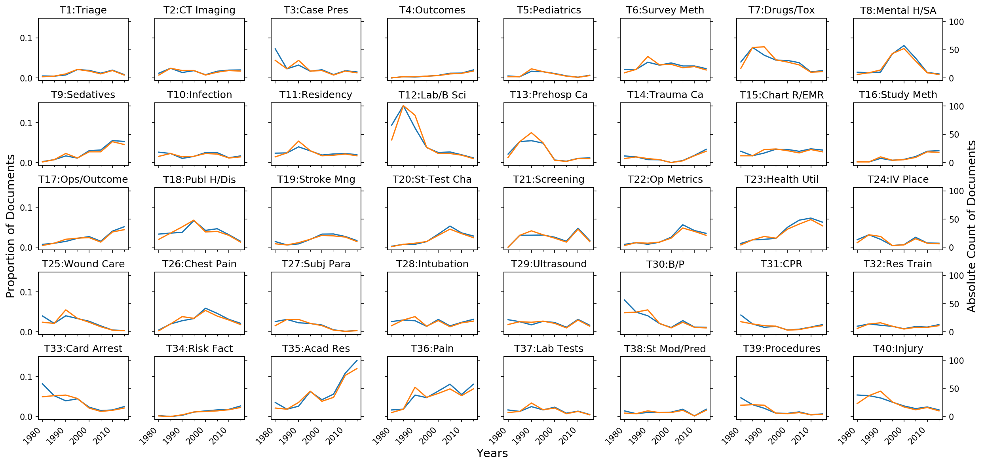
Supplemental Figure 6 – Annals of EM

Slide 18
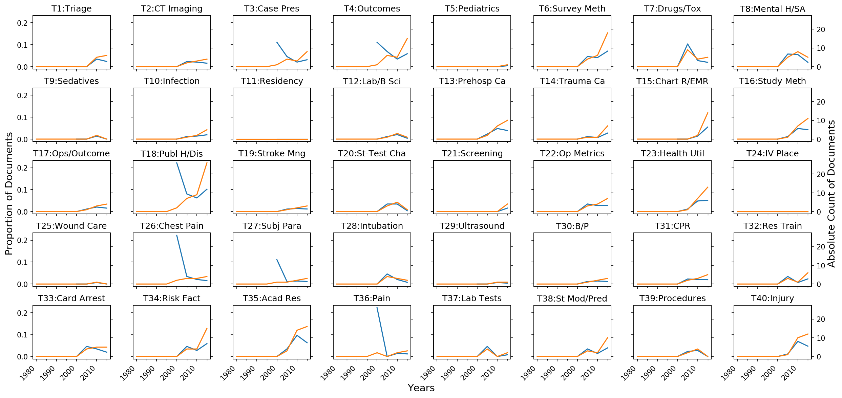
Supplemental Figure 7 – BMC EM

Slide 19
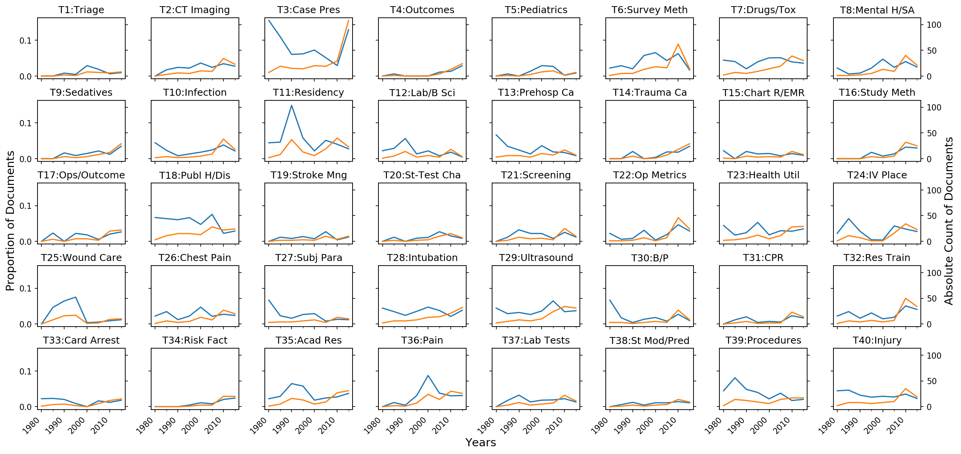
Supplemental Figure 8 – Journal of EM

Slide 20
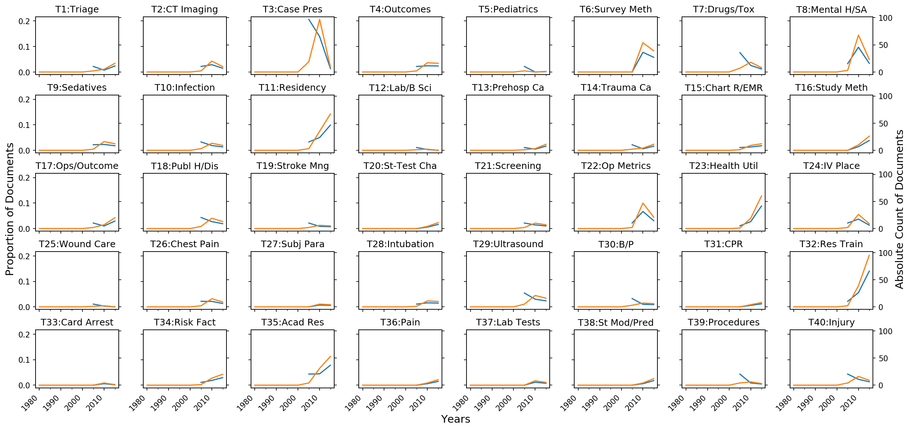
Supplemental Figure 9 – The W J of EM

